Slide 1
Welcome!
Before Lecture:
1. Re-orientation
2. Twenty-Minute Rule
3. Be Humble ( and teach )
4. Syllabus and Course Objectives

Slide 2
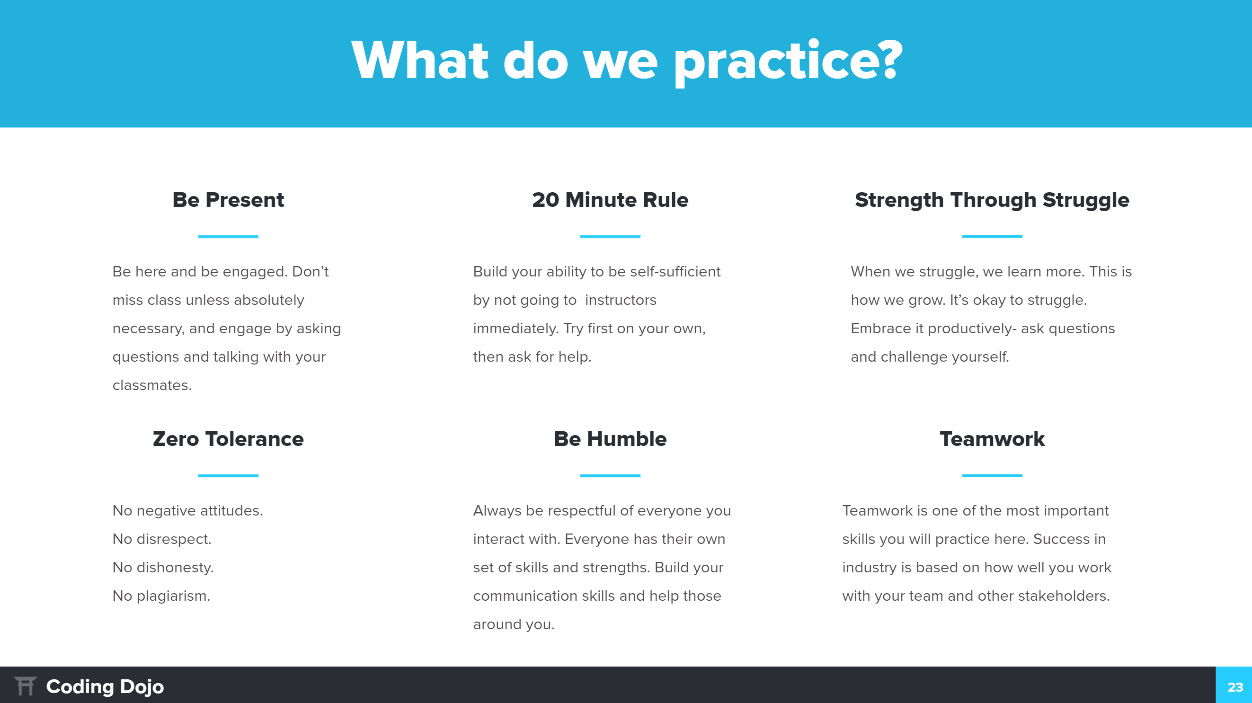

Slide 4
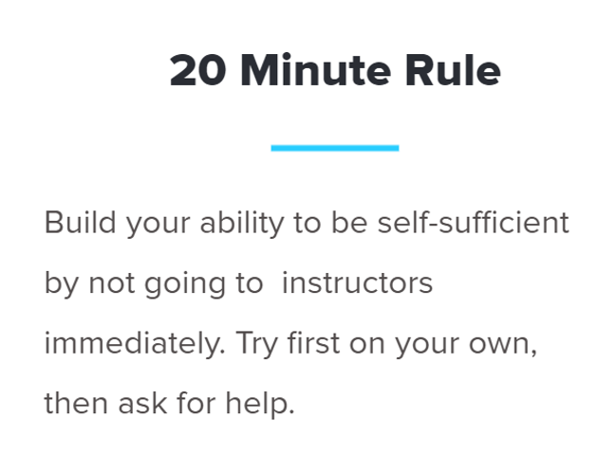
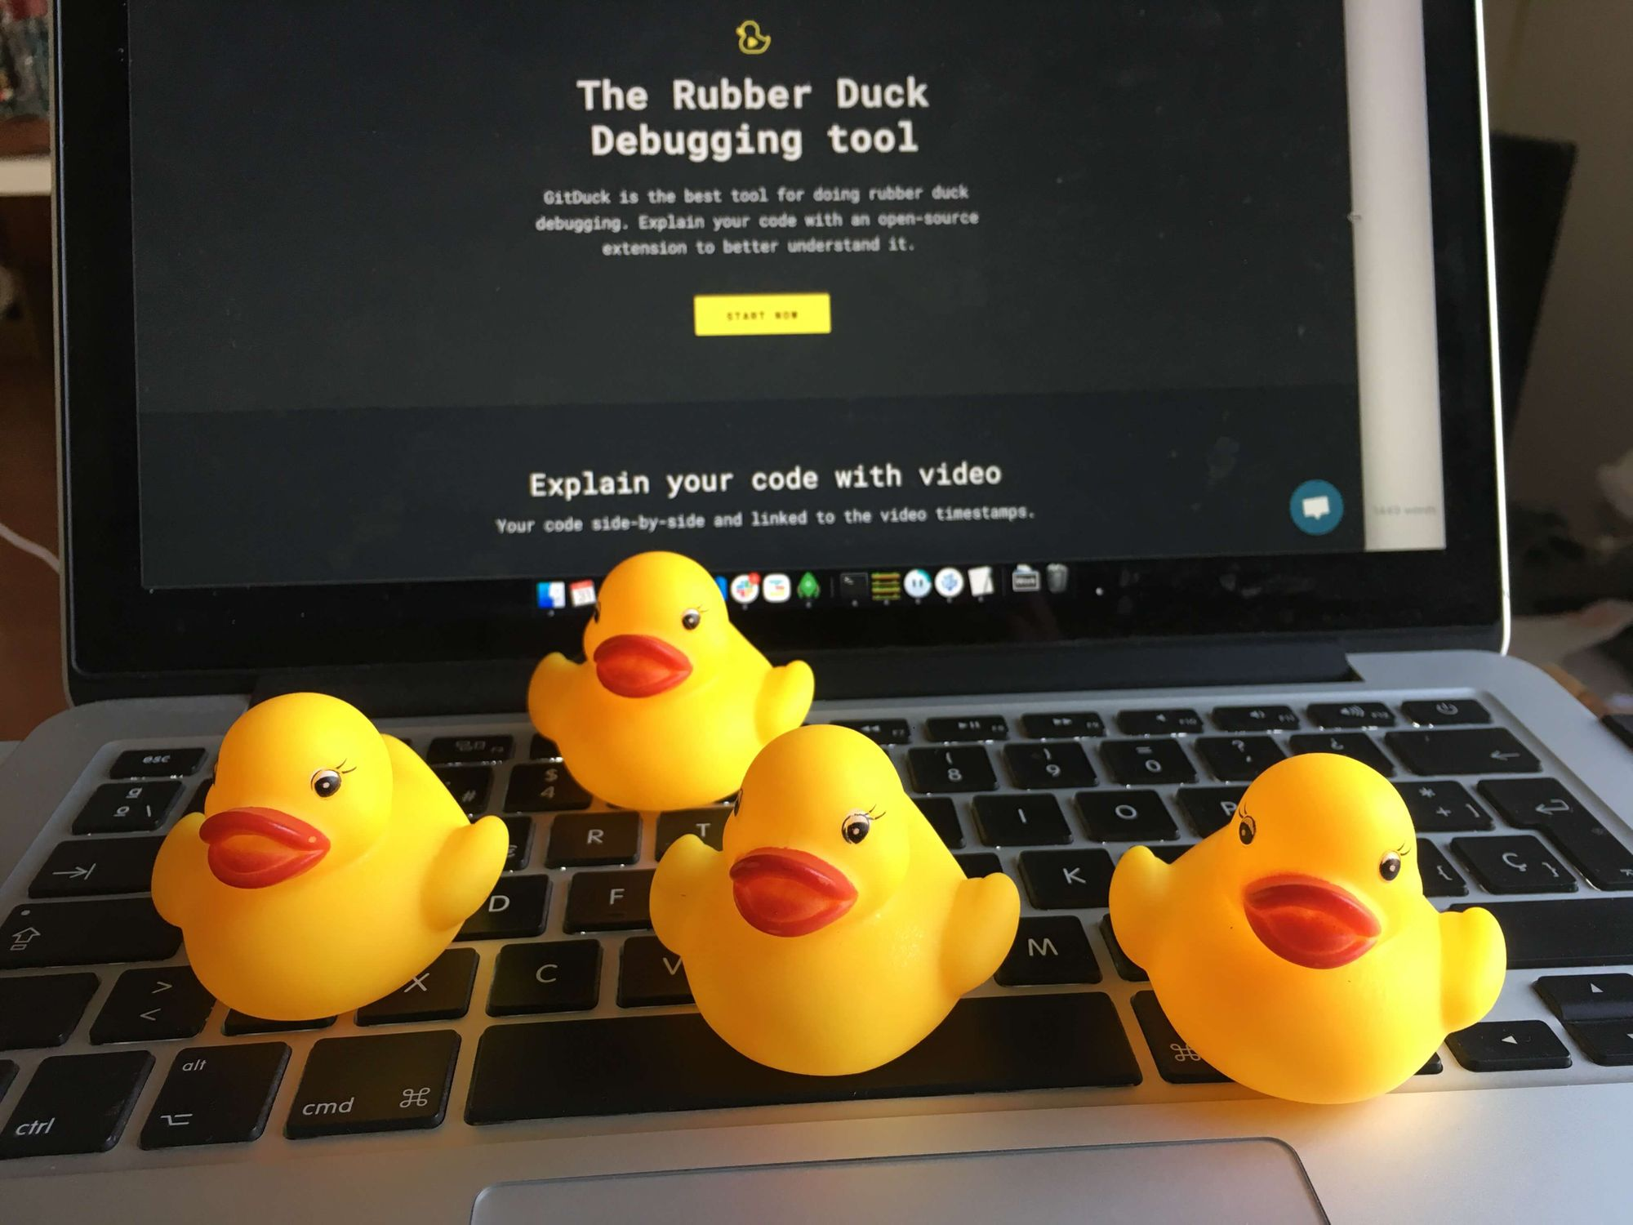
First 20 Minutes:
Google
Error messages
If your question has been asked before
Best ways to
Check the official documentation
Check “User Groups”
Ask a Group Member or Friend
“Rubber Ducky” Method

Slide 5
First 20 Minutes:
Google
Error messages
If your question has been asked before
“Best ways to”
Check the official documentation
Check “User Groups”
Ask a Group Member or Friend
“Rubber Ducky” Method

Slide 6
First 20 Minutes:
Google
Error messages
If your question has been asked before
“Best ways to”
Check the official documentation
Check “User Groups”
Ask a Group Member or Friend
“Rubber Ducky” Method
After 20 Minutes:
Direct Message TA/Instructor in Slack
Message on Matter Most
Email Instructor or TA

Slide 7
First 20 Minutes:
Google
Error messages
If your question has been asked before
“Best ways to”
Check the official documentation
Check “User Groups”
Ask a Group Member or Friend
“Rubber Ducky” Method
After 20 Minutes:
Direct Message TA/Instructor in Slack
Message on Matter Most
Email Instructor or TA

Slide 8
First 20 Minutes:
Google
Error messages
If your question has been asked before
“Best ways to”
Check the official documentation
Check “User Groups”
Ask a Group Member or Friend
“Rubber Ducky” Method
After 20 Minutes:
Direct Message TA/Instructor in Slack
Message on Matter Most
Email Instructor or TA

Slide 9
First 20 Minutes:
Google
Error messages
If your question has been asked before
Best ways to
Check the official documentation
Check “User Groups”
Ask a Group Member or Friend
“Rubber Ducky” Method
After 20 Minutes:
Direct Message TA/Instructor in Slack
Message on Matter Most
Email Instructor or TA

Slide 10
Revisit Syllabus

Slide 11
Introductions

Slide 12



FinTech
Reminders & Rules:
📹 Lecture will be recorded
Please keep microphones off while not asking questions
✋ Please raise your hand with a zoom Emoji
or
💬 Write in the chat box to ask a question
😃 Video Participation is encouraged but not required

Slide 13
Introduction To Fintech
FinTech
Jonathan Mikkila
Coding Dojo & SDA

Slide 14
Learning Objectives

Slide 15
Learning Objectives
Be able to answer “What is FinTech?”

Slide 16
Learning Objectives
Be able to answer “What is FinTech?”
Familiarized to the History of Fintech –
Specifically:
Fintech 1.0, 2.0, 3.0

Slide 17
Outline
Fintech – Finance meets Technology

Slide 18
Outline
Fintech – Finance meets Technology
What is FinTech?
According to who?

Slide 19
Outline
Fintech – Finance meets Technology
What is FinTech?
According to who?
FinTech 1.0 (1866), 2.0 (1967), 3.0 (2008)
The Framework of Douglas Arner, Ross Buckley & Janos Barberis
Ancient Fintech (2300 BC, 1700 AD) & Prehistory (44, 000 BC)
A look to the future
Money and Contracts as Software

Slide 20
Outline
Fintech – Finance meets Technology
What is FinTech?
According to who?
FinTech 1.0 (1866), 2.0 (1967), 3.0 (2008)
The Framework of Douglas Arner, Ross Buckley & Janos Barberis
Ancient Fintech (2300 BC, 1700 AD) & Prehistory (44, 000 BC)
A look to the future
Money and Contracts as Software
4. How does this connect with our Course content and Requirements.

Slide 21
Outline
Fintech – Finance meets Technology
What is FinTech?
According to who?
FinTech 1.0 (1866), 2.0 (1967), 3.0 (2008)

Slide 22
Outline
Fintech – Finance meets Technology
What is FinTech?
According to who?
FinTech 1.0 (1866), 2.0 (1967), 3.0 (2008)
The Framework of Douglas Arner, Ross Buckley & Janos Barberis
Ancient Fintech (2300 BC, 1700 AD) & Prehistory (44, 000 BC)

Slide 23
FinTech

Slide 24
FinTech
Finance

Slide 25
FinTech
Finance
Technology

Slide 26
Finance
- Term for matters regarding the management, creation, and study of money and investments. (Investopedia)

Slide 27
Technology
The means and equipment for realizing material objectives.
(Wikipedia)

Slide 28
FinTech – One Word, Many Meanings

Slide 29
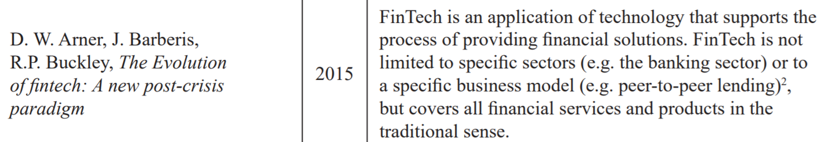
FinTech – One Word, Many Meanings
FinTech – According to who?
Patrycja Ratecka, 2020. "FinTech - definition, taxonomy and historical approach,“.
Malopolska School of Economics in Tarnow, vol. 45(1), pages 53-67, March.

Slide 30
FinTech – One Word, Many Meanings
FinTech – According to who?
Patrycja Ratecka, 2020. "FinTech - definition, taxonomy and historical approach,“.
Malopolska School of Economics in Tarnow, vol. 45(1), pages 53-67, March.

Slide 31
FinTech – One Word, Many Meanings
FinTech – According to who?
Patrycja Ratecka, 2020. "FinTech - definition, taxonomy and historical approach,“.
Malopolska School of Economics in Tarnow, vol. 45(1), pages 53-67, March.

Slide 32
FinTech – One Word, Many Meanings
FinTech – According to who?
An Applied Technology (providing financial services )
Patrycja Ratecka, 2020. "FinTech - definition, taxonomy and historical approach,“.
Malopolska School of Economics in Tarnow, vol. 45(1), pages 53-67, March.

Slide 33
FinTech – One Word, Many Meanings
FinTech – According to who?
Patrycja Ratecka, 2020. "FinTech - definition, taxonomy and historical approach,“.
Malopolska School of Economics in Tarnow, vol. 45(1), pages 53-67, March.

Slide 34
FinTech – One Word, Many Meanings
FinTech – According to who?
A Company – employing technology in Finance
Patrycja Ratecka, 2020. "FinTech - definition, taxonomy and historical approach,“.
Malopolska School of Economics in Tarnow, vol. 45(1), pages 53-67, March.

Slide 35
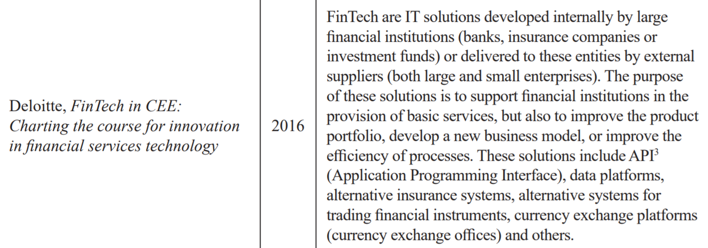
FinTech – One Word, Many Meanings
FinTech – According to who?
Patrycja Ratecka, 2020. "FinTech - definition, taxonomy and historical approach,“.
Malopolska School of Economics in Tarnow, vol. 45(1), pages 53-67, March.

Slide 36
FinTech – One Word, Many Meanings
FinTech – According to who?
Patrycja Ratecka, 2020. "FinTech - definition, taxonomy and historical approach,“.
Malopolska School of Economics in Tarnow, vol. 45(1), pages 53-67, March.

Slide 37
FinTech – One Word, Many Meanings
FinTech – According to who?
Patrycja Ratecka, 2020. "FinTech - definition, taxonomy and historical approach,“.
Malopolska School of Economics in Tarnow, vol. 45(1), pages 53-67, March.

Slide 38
FinTech – One Word, Many Meanings
FinTech – According to who?
Patrycja Ratecka, 2020. "FinTech - definition, taxonomy and historical approach,“.
Malopolska School of Economics in Tarnow, vol. 45(1), pages 53-67, March.

Slide 39
FinTech – One Word, Many Meanings
FinTech – According to who?
The IT Solutions
Specifically developed
by large Incumbents
or
small companies serving them:
Eg: APIs, ATS, PaaS
Patrycja Ratecka, 2020. "FinTech - definition, taxonomy and historical approach,“.
Malopolska School of Economics in Tarnow, vol. 45(1), pages 53-67, March.

Slide 40
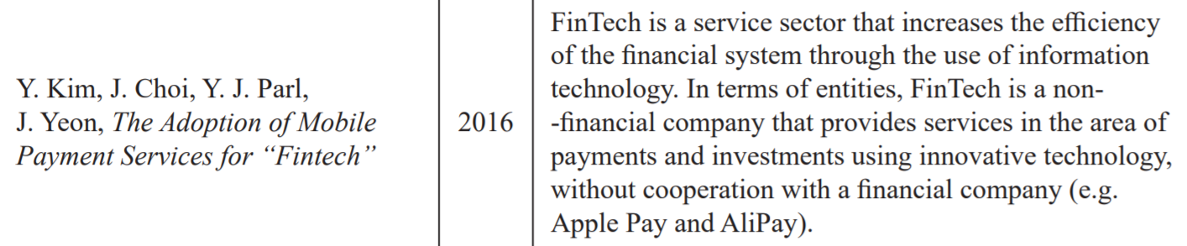
FinTech – One Word, Many Meanings
FinTech – According to who?
Patrycja Ratecka, 2020. "FinTech - definition, taxonomy and historical approach,“.
Malopolska School of Economics in Tarnow, vol. 45(1), pages 53-67, March.

Slide 41
FinTech – One Word, Many Meanings
FinTech – According to who?
AND
Patrycja Ratecka, 2020. "FinTech - definition, taxonomy and historical approach,“.
Malopolska School of Economics in Tarnow, vol. 45(1), pages 53-67, March.

Slide 42
FinTech – One Word, Many Meanings
FinTech – According to who?
An entire Sector
+
Non-Finance Companies that do Finance.
AND
Patrycja Ratecka, 2020. "FinTech - definition, taxonomy and historical approach,“.
Malopolska School of Economics in Tarnow, vol. 45(1), pages 53-67, March.

Slide 43
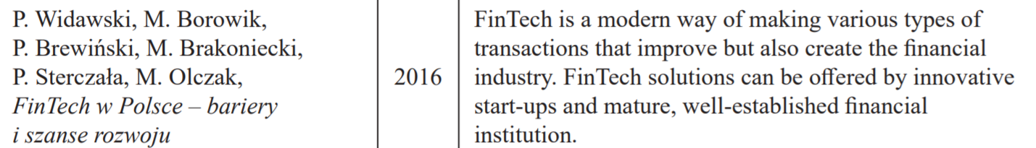
FinTech – One Word, Many Meanings
FinTech – According to who?
Patrycja Ratecka, 2020. "FinTech - definition, taxonomy and historical approach,“.
Malopolska School of Economics in Tarnow, vol. 45(1), pages 53-67, March.

Slide 44
FinTech – One Word, Many Meanings
FinTech – According to who?
A way of doing transactions
Patrycja Ratecka, 2020. "FinTech - definition, taxonomy and historical approach,“.
Malopolska School of Economics in Tarnow, vol. 45(1), pages 53-67, March.

Slide 45
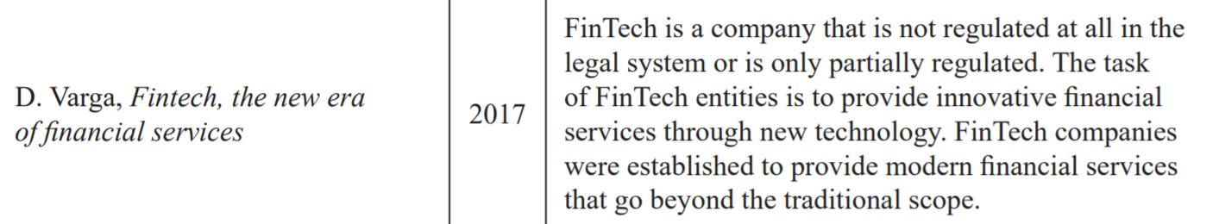
FinTech – One Word, Many Meanings
FinTech – According to who?
Patrycja Ratecka, 2020. "FinTech - definition, taxonomy and historical approach,“.
Malopolska School of Economics in Tarnow, vol. 45(1), pages 53-67, March.

Slide 46
FinTech – One Word, Many Meanings
FinTech – According to who?
Patrycja Ratecka, 2020. "FinTech - definition, taxonomy and historical approach,“.
Malopolska School of Economics in Tarnow, vol. 45(1), pages 53-67, March.

Slide 47
FinTech – One Word, Many Meanings
FinTech – According to who?
An Unregulated Finance Company using new technology.
Patrycja Ratecka, 2020. "FinTech - definition, taxonomy and historical approach,“.
Malopolska School of Economics in Tarnow, vol. 45(1), pages 53-67, March.

Slide 48
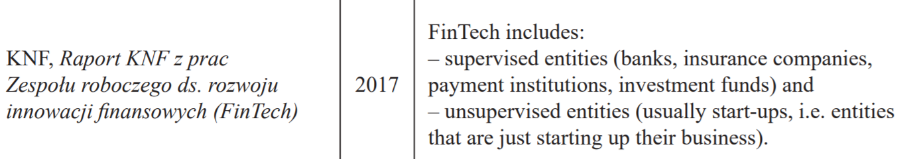
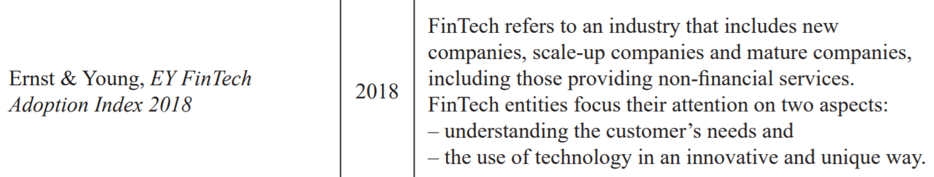
FinTech – One Word, Many Meanings
FinTech – According to who?
Patrycja Ratecka, 2020. "FinTech - definition, taxonomy and historical approach,“.
Malopolska School of Economics in Tarnow, vol. 45(1), pages 53-67, March.

Slide 49
FinTech – One Word, Many Meanings
FinTech – According to who?
Patrycja Ratecka, 2020. "FinTech - definition, taxonomy and historical approach,“.
Malopolska School of Economics in Tarnow, vol. 45(1), pages 53-67, March.

Slide 50
FinTech – One Word, Many Meanings
FinTech – According to who?
An Industry. With a focus on customers needs and unique solutions.
Patrycja Ratecka, 2020. "FinTech - definition, taxonomy and historical approach,“.
Malopolska School of Economics in Tarnow, vol. 45(1), pages 53-67, March.

Slide 51
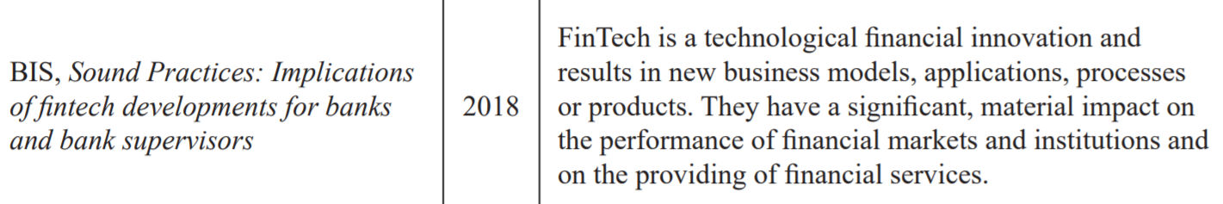
FinTech – One Word, Many Meanings
FinTech – According to who?
Patrycja Ratecka, 2020. "FinTech - definition, taxonomy and historical approach,“.
Malopolska School of Economics in Tarnow, vol. 45(1), pages 53-67, March.

Slide 52
FinTech – One Word, Many Meanings
FinTech – According to who?
Patrycja Ratecka, 2020. "FinTech - definition, taxonomy and historical approach,“.
Malopolska School of Economics in Tarnow, vol. 45(1), pages 53-67, March.

Slide 53
FinTech – One Word, Many Meanings
FinTech – According to who?
High Impact Innovation.
Patrycja Ratecka, 2020. "FinTech - definition, taxonomy and historical approach,“.
Malopolska School of Economics in Tarnow, vol. 45(1), pages 53-67, March.

Slide 54
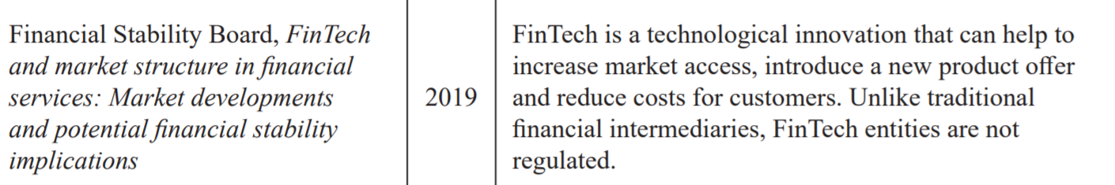
FinTech – One Word, Many Meanings
FinTech – According to who?
Patrycja Ratecka, 2020. "FinTech - definition, taxonomy and historical approach,“.
Malopolska School of Economics in Tarnow, vol. 45(1), pages 53-67, March.

Slide 55
FinTech – One Word, Many Meanings
FinTech – According to who?
Patrycja Ratecka, 2020. "FinTech - definition, taxonomy and historical approach,“.
Malopolska School of Economics in Tarnow, vol. 45(1), pages 53-67, March.

Slide 56
FinTech – One Word, Many Meanings
FinTech – According to who?
Financial Innovation & Unregulated Companies
Patrycja Ratecka, 2020. "FinTech - definition, taxonomy and historical approach,“.
Malopolska School of Economics in Tarnow, vol. 45(1), pages 53-67, March.

Slide 57
FinTech – One Word, Many Meanings
FinTech is:

Slide 58
FinTech – One Word, Many Meanings
FinTech is:
An Applied Technology (providing financial services )

Slide 59
FinTech – One Word, Many Meanings
FinTech is:
An Applied Technology (providing financial services )

Slide 60
FinTech – One Word, Many Meanings
FinTech is:
An Applied Technology (providing financial services )
An Industry. With a focus on customers needs and unique solutions.

Slide 61
FinTech – One Word, Many Meanings
FinTech is:
An Applied Technology (providing financial services )
An Industry With a focus on customers needs and unique solutions.

Slide 62
FinTech – One Word, Many Meanings
FinTech is:
An Applied Technology (providing financial services )
An Industry With a focus on customers needs and unique solutions.
The IT Solutions

Slide 63
FinTech – One Word, Many Meanings
FinTech is:
An entire Sector
+
Non-Finance Companies that do Finance.
An Applied Technology (providing financial services )
An Industry With a focus on customers needs and unique solutions.
The IT Solutions

Slide 64
FinTech – One Word, Many Meanings
FinTech is:
An entire Sector
+
Non-Finance Companies that do Finance.
An Applied Technology (providing financial services )
An Industry With a focus on customers needs and unique solutions.
The IT Solutions

Slide 65
FinTech – One Word, Many Meanings
FinTech is:
An entire Sector
+
Non-Finance Companies that do Finance.
An Applied Technology (providing financial services )
An Industry With a focus on customers needs and unique solutions.
The IT Solutions

Slide 66
FinTech – One Word, Many Meanings
FinTech is:
An entire Sector
+
Non-Finance Companies that do Finance.
An Applied Technology (providing financial services )
An Industry With a focus on customers needs and unique solutions.
The IT Solutions
An Unregulated Finance Company using new technology.

Slide 67
FinTech – One Word, Many Meanings
FinTech is:
An entire Sector
+
Non-Finance Companies that do Finance.
An Applied Technology (providing financial services )
An Industry With a focus on customers needs and unique solutions.
The IT Solutions
An Unregulated Finance Company using new technology.

Slide 68
FinTech – One Word, Many Meanings
FinTech is:
An entire Sector
+
Non-Finance Companies that do Finance.
An Applied Technology (providing financial services )
An Industry With a focus on customers needs and unique solutions.
The IT Solutions
An Unregulated Finance Company using new technology.
A way of doing transactions

Slide 69
FinTech – One Word, Many Meanings
FinTech is:
An entire Sector
+
Non-Finance Companies that do Finance.
An Applied Technology (providing financial services )
An Industry With a focus on customers needs and unique solutions.
The IT Solutions
An Unregulated Finance Company using new technology.
A way of doing Transactions
Financial Innovation & Unregulated Companies

Slide 70
FinTech – One Word, Many Meanings
FinTech is:
An entire Sector
+
Non-Finance Companies that do Finance.
An Applied Technology (providing financial services )
An Industry With a focus on customers needs and unique solutions.
The IT Solutions
An Unregulated Finance Company using new technology.
A way of doing Transactions
High Impact Innovation.
Financial Innovation & Unregulated Companies

Slide 71
FinTech – One Word, Many Meanings
FinTech is:
An entire Sector
+
Non-Finance Companies that do Finance.
An Applied Technology (providing financial services )
An Industry With a focus on customers needs and unique solutions.
The IT Solutions
An Unregulated Finance Company using new technology.
A way of doing Transactions
High Impact Innovation
Financial Innovation & Unregulated Companies

Slide 72
Did we miss any?

Slide 73
Did we miss any?
Do you agree with them all?

Slide 74
History of Fintech

Slide 75
History of Fintech
Douglas Anwer and Fintech 1.0, 2.0, 3.0
Ancient Fintech
Fintech into the Future 🚀

Slide 76
FinTech 1.0, 2.0, 3.0

Slide 77
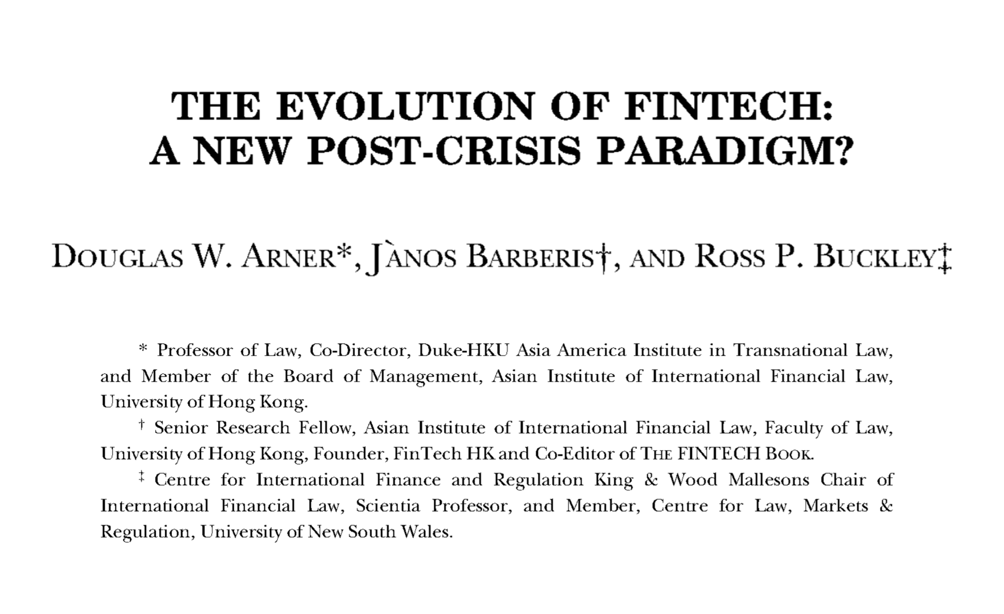
FinTech 1.0, 2.0, 3.0
A, Douglas, et al. (2015). The Evolution of Fintech: A New Post-Crisis Paradigm?. UHK Faculty of Law Research Paper No. 047. http://dx.doi.org/10.2139/ssrn.2676553

Slide 78
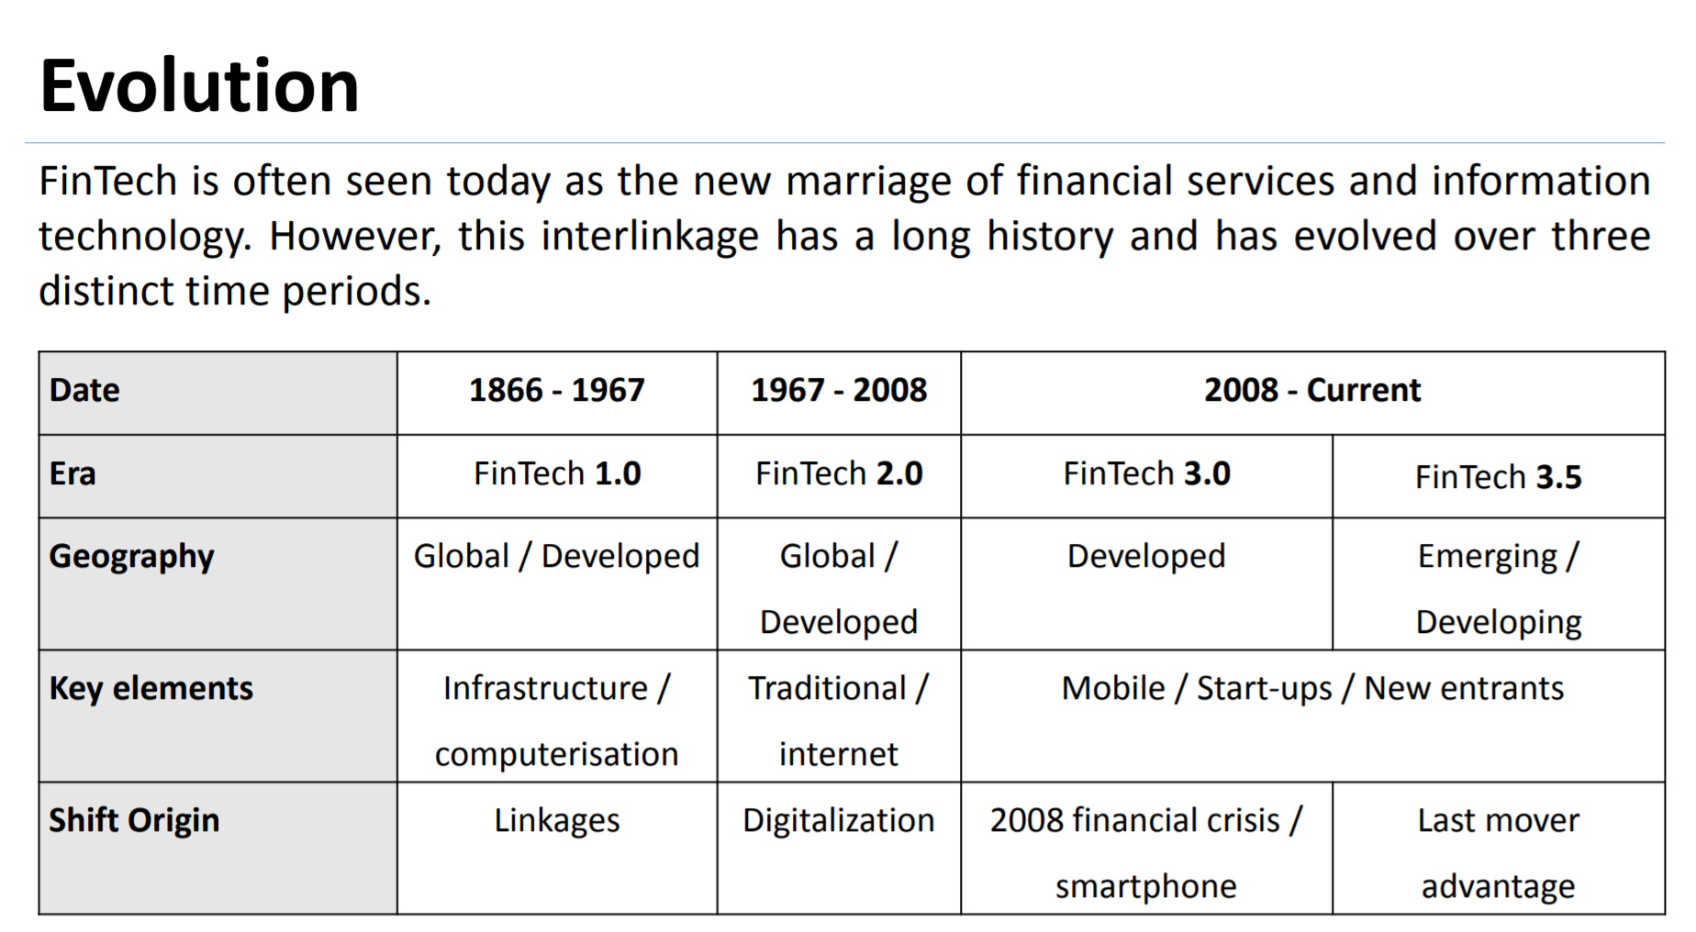
FinTech 1.0, 2.0, 3.0
law.unimelb.edu.au: D Arner FinTech-Evolution Melbourne June-2016 Slides

Slide 79
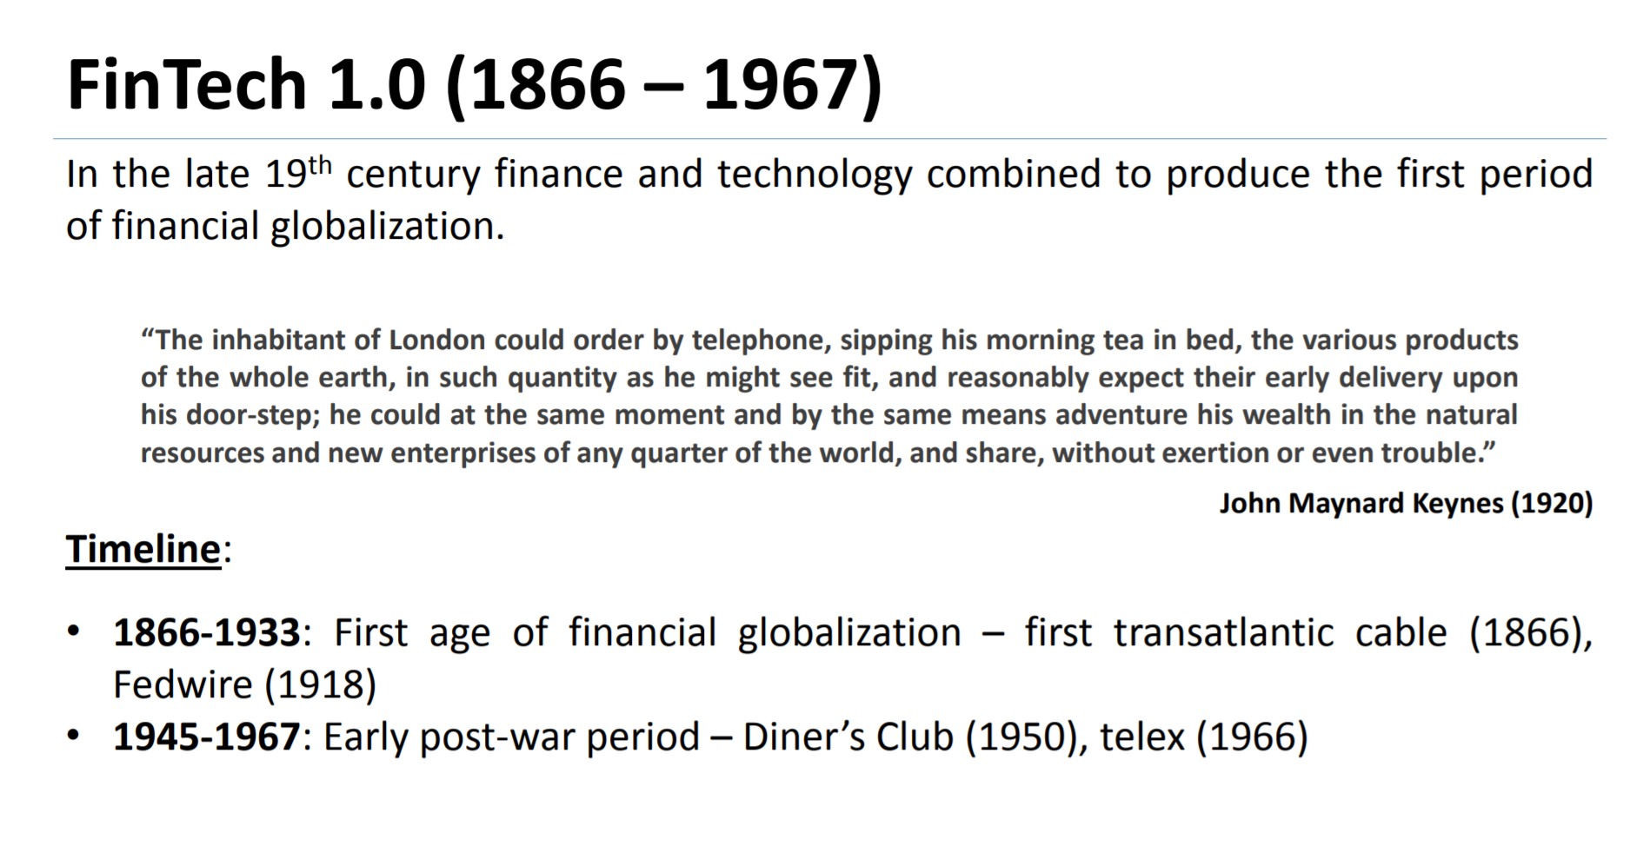
FinTech 1.0
law.unimelb.edu.au: D Arner FinTech-Evolution Melbourne June-2016 Slides

Slide 80
FinTech 1.0, 2.0, 3.0
law.unimelb.edu.au: D Arner FinTech-Evolution Melbourne June-2016 Slides

Slide 81
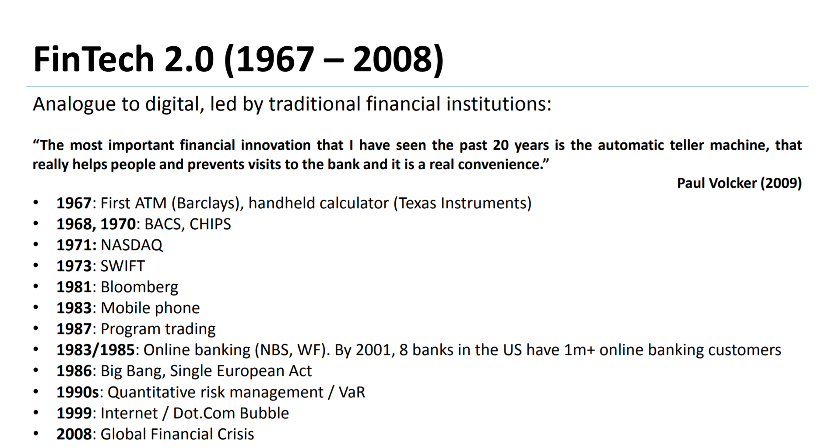
FinTech 2.0
law.unimelb.edu.au: D Arner FinTech-Evolution Melbourne June-2016 Slides

Slide 82
FinTech 1.0, 2.0, 3.0
law.unimelb.edu.au: D Arner FinTech-Evolution Melbourne June-2016 Slides

Slide 83
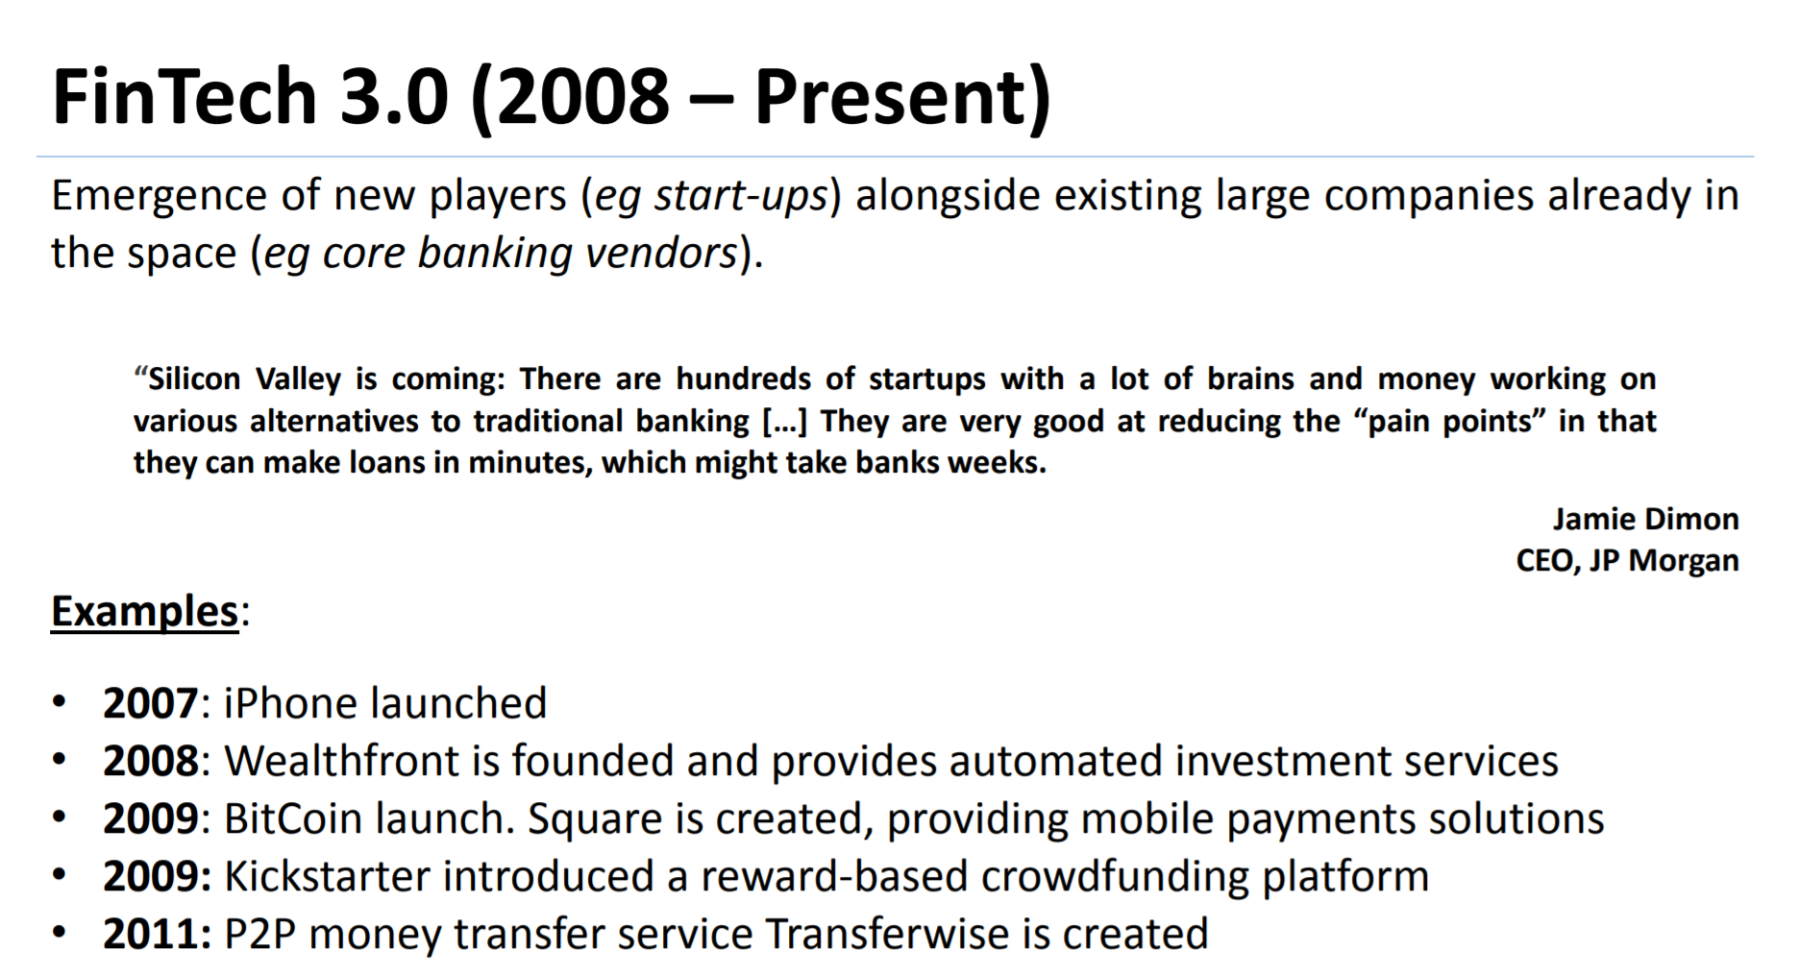
FinTech 2.0
law.unimelb.edu.au: D Arner FinTech-Evolution Melbourne June-2016 Slides

Slide 84
FinTech 1.0, 2.0, 3.0
law.unimelb.edu.au: D Arner FinTech-Evolution Melbourne June-2016 Slides

Slide 85

Ancient Fintech
Can anyone guess
what this was for?
Dated to ~35,000 BC

Slide 86
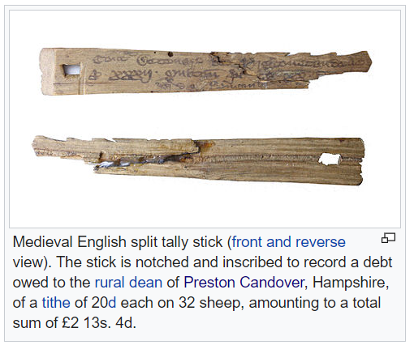
Ancient Fintech
https://en.wikipedia.org/wiki/Tally_stick

Slide 87
Ancient Fintech
The system of tally marks of the Exchequer is described in The Dialogue Concerning the Exchequer as follows:
The manner of cutting is as follows.
At the top of the tally a cut is made,
the thickness of the palm of the hand, to represent a thousand pounds;
then a hundred pounds by a cut the breadth of a thumb;
twenty pounds, the breadth of the little finger; a single pound,
the width of a swollen barleycorn; a shilling rather narrower;
then a penny is marked by a single cut without removing any wood.
https://en.wikipedia.org/wiki/Tally_stick

Slide 88

Ancient Fintech
1697
https://en.wikipedia.org/wiki/Tally_stick

Slide 89
Ancient Fintech
1697
Royal tallies (debt of the Crown) played a role in the formation of the Bank of England at the end of the 17th century.
the bank issued £1 million worth of stock in exchange for £800,000 worth of tallies at par and £200,000 in bank notes. This new stock was said to be "engrafted". The government promised not only to pay the Bank interest on the tallies subscribed but to redeem them over a period of years. The "engrafted" stock was then cancelled simultaneously with the redemption.^{[10]}
https://en.wikipedia.org/wiki/Tally_stick

Slide 90

Ancient Fintech
1697
Royal tallies (debt of the Crown) played a role in the formation of the Bank of England at the end of the 17th century.
the bank issued £1 million worth of stock in exchange for £800,000 worth of tallies at par and £200,000 in bank notes. This new stock was said to be "engrafted". The government promised not only to pay the Bank interest on the tallies subscribed but to redeem them over a period of years. The "engrafted" stock was then cancelled simultaneously with the redemption.^{[10]}
https://en.wikipedia.org/wiki/Tally_stick

Slide 91
Ancient Fintech

Slide 92

Ancient Fintech
?

Slide 93
Ancient Fintech
Technical Analysis – aka – Charting.

Slide 94
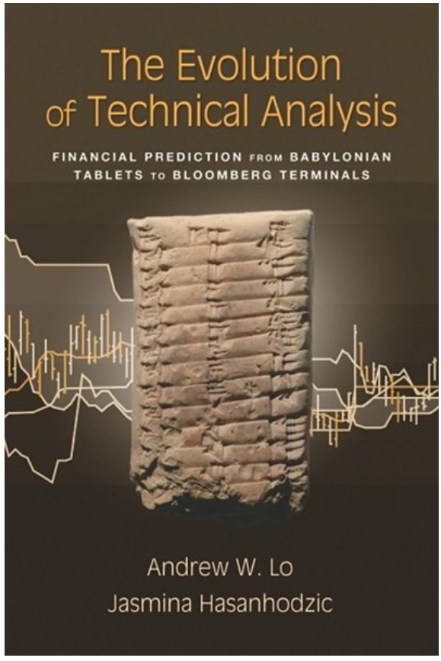
Ancient Fintech

Slide 95

Ancient Fintech
Neo-Babylonian Clay Tablet. Tablet Documenting The Prices Of Various Commodities, 6Th

Slide 96

Ancient Fintech
Bloomberg Terminal
Neo-Babylonian Clay Tablet. Tablet Documenting The Prices Of Various Commodities, 6Th

Slide 97
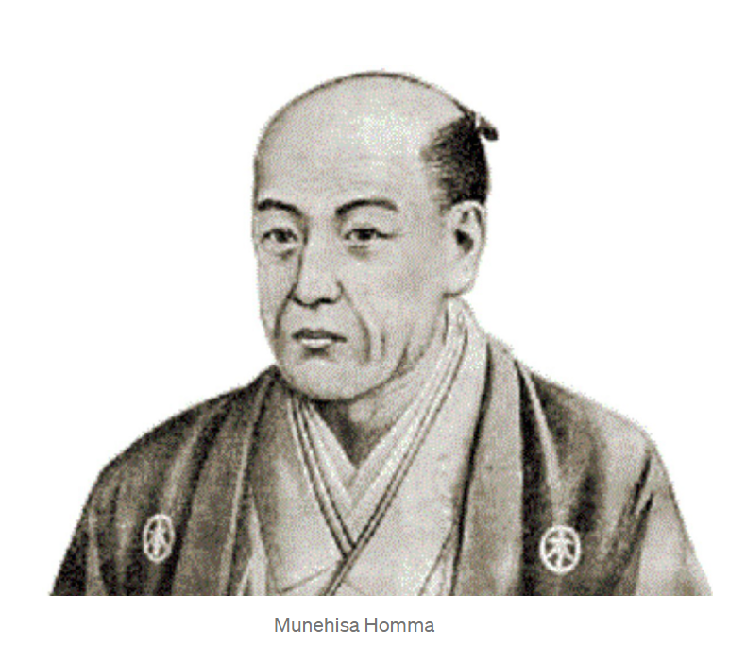
Ancient Fintech
The Rice Billionaire
Born 1724, Sakata, Japan

Slide 98
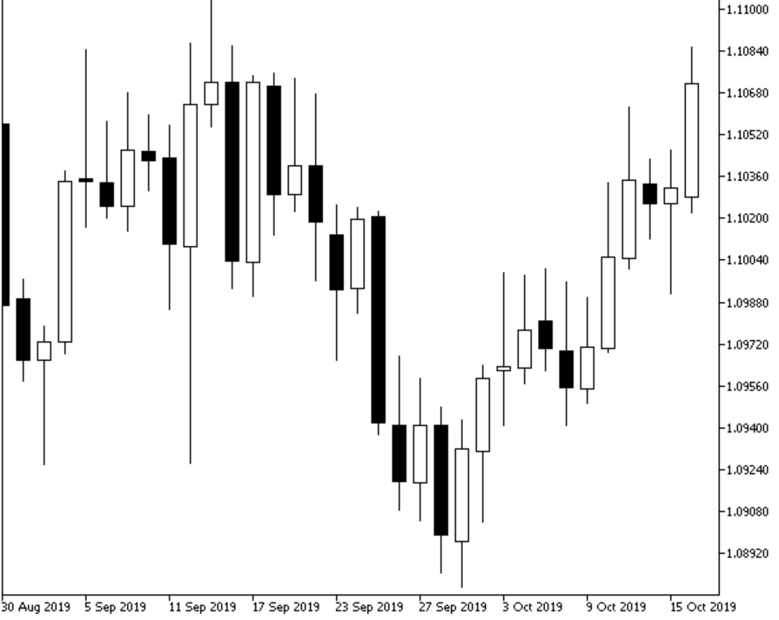
Ancient Fintech
The Rice Billionaire
Born 1724, Sakata, Japan

Slide 99
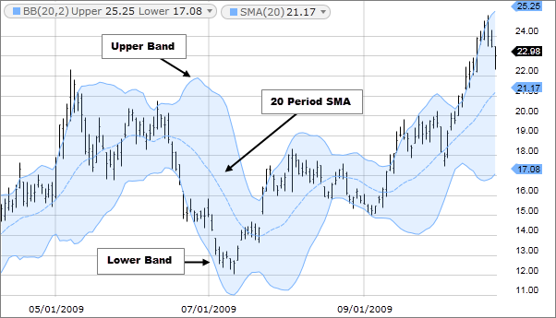
Ancient Fintech

Slide 100
The Future of Fintech

Slide 101
The Future of Fintech
Money and Contracts as Code

Slide 102

The Future of Fintech
Money and Contracts as Code

Slide 103
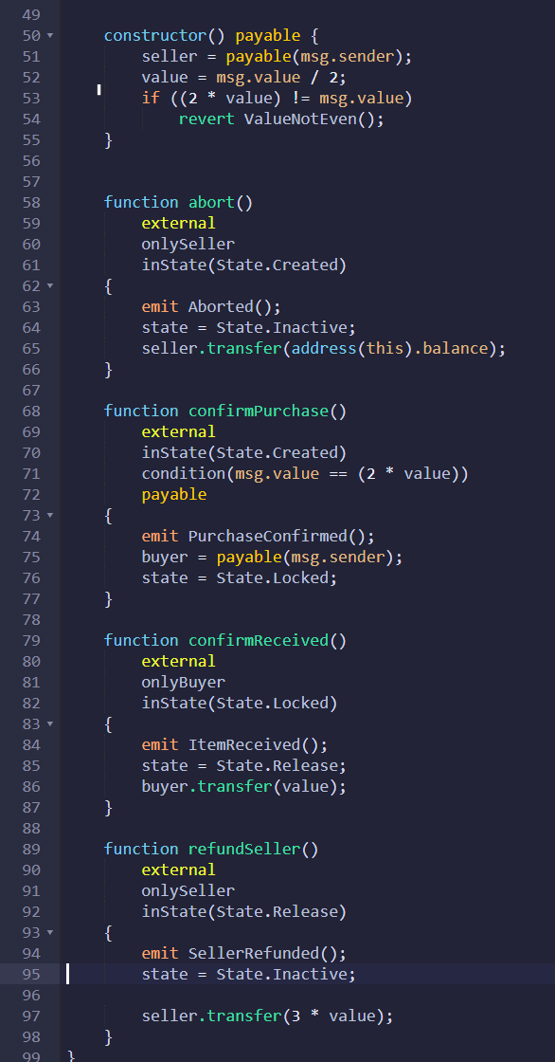
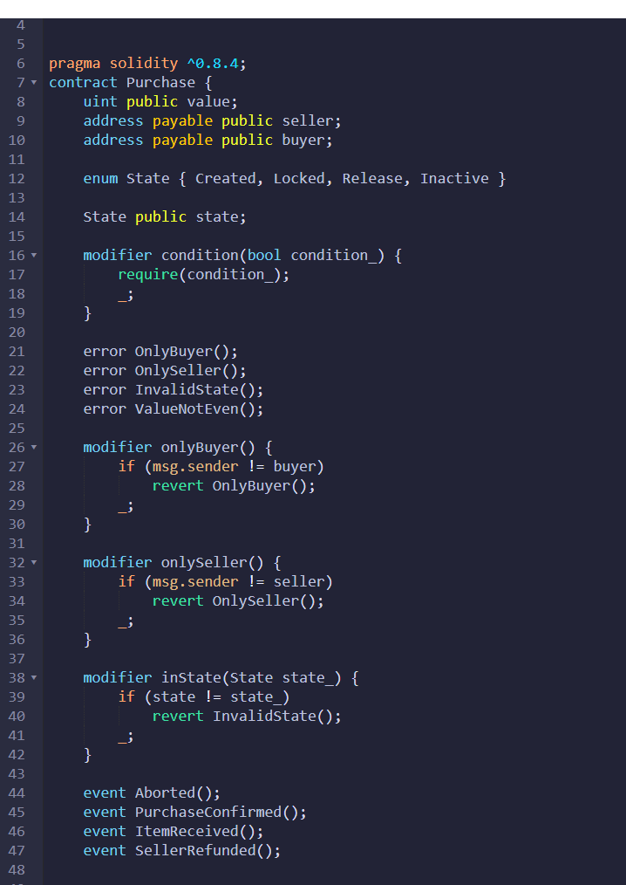
The Future of Fintech
Money and Contracts as Code

